Slide 1


Slide 2
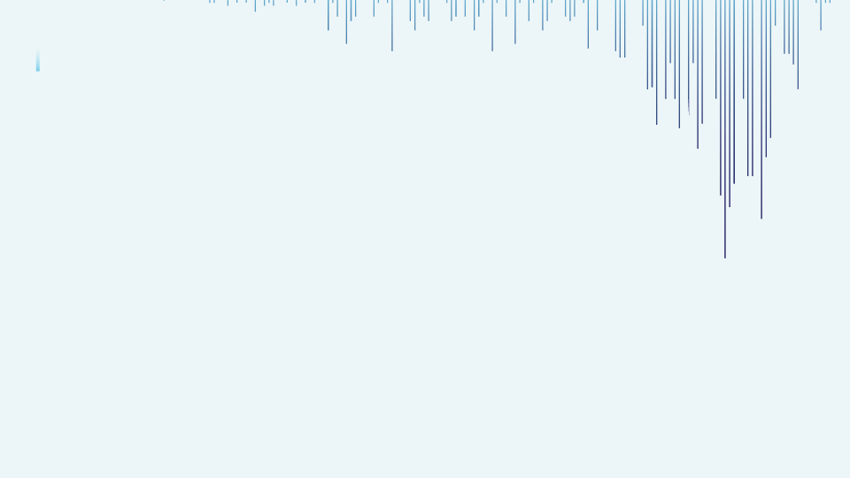

CAPSTONE
project
Presented by
Mr. Rohit Chhikara

Slide 3
DOMAIN -
MEDICAL
Project -
FETAL HEALTH CLASSIFICATION

Slide 4
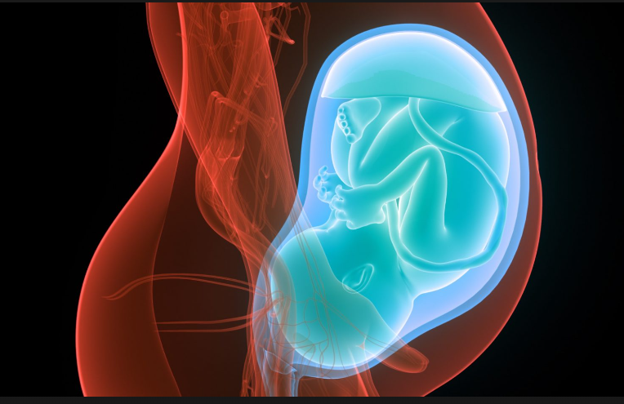
Fetal_health
Fetal health refers to the well-being and condition of a developing fetus during pregnancy.

Slide 5
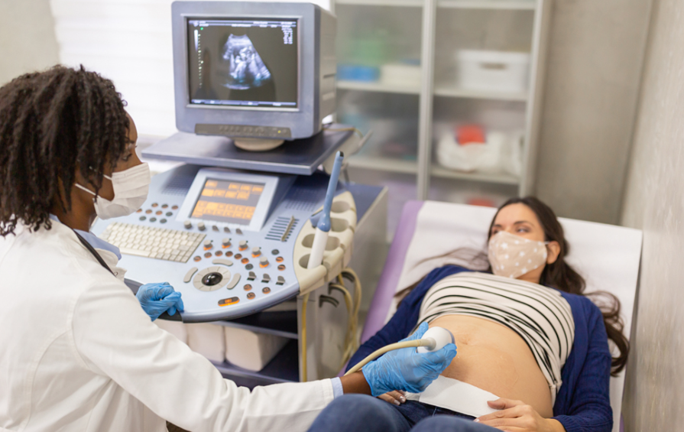
What is fetal health classification and Why do we need it?
Fetal health classification refers to the evaluation and categorization of the health status of a developing fetus during pregnancy. It is crucial for several reasons, as it plays a key role in ensuring the well-being of both the developing fetus and the expectant mother. Here are some reasons why fetal health classification is important:
Early Detection of Abnormalities.
Prevention of Complications.
Reduce mortality rate.
Risk Assessment and Management.
Research and Data Collection.

Slide 6
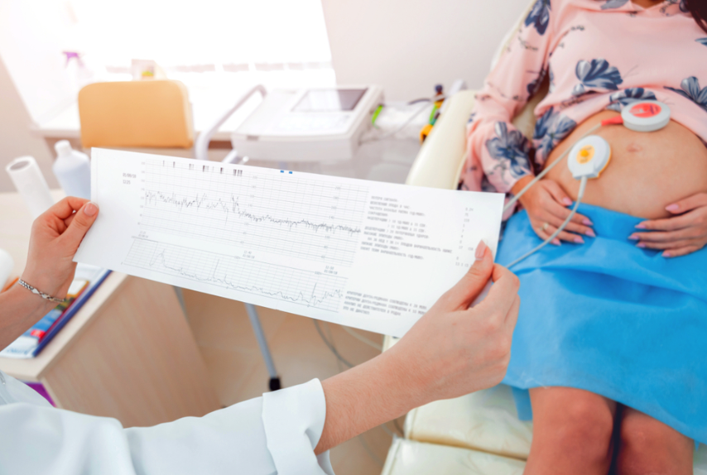
How can we classify fetal health?
With the help of data from Cardiotocography machine.

Slide 7
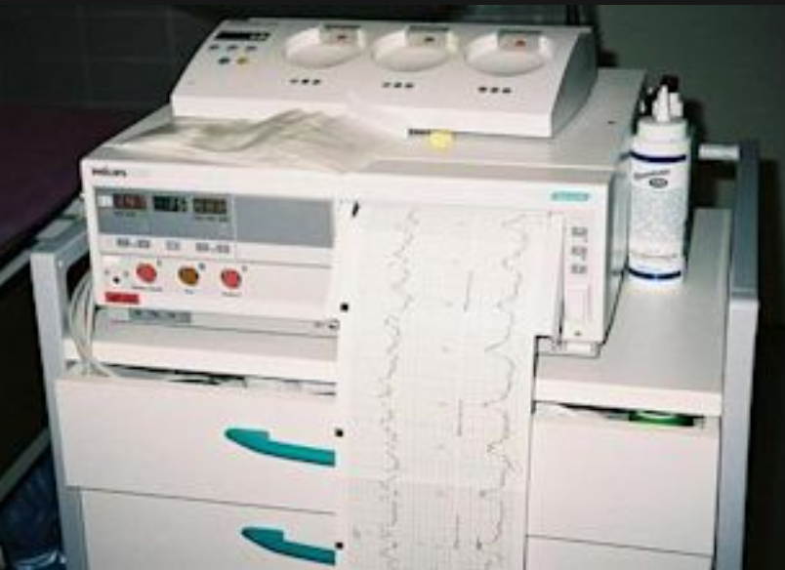
What is Cardiotography machine?
The most used technique for detecting fetal distress during the antepartum and early postpartum period is cardiotocography (CTG).Based on its data, doctors can determine whether the fetal condition is normal, suspicious, or pathological.

Slide 8
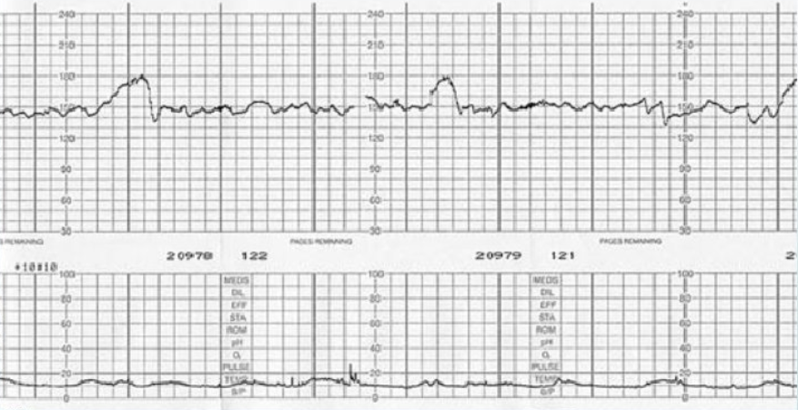
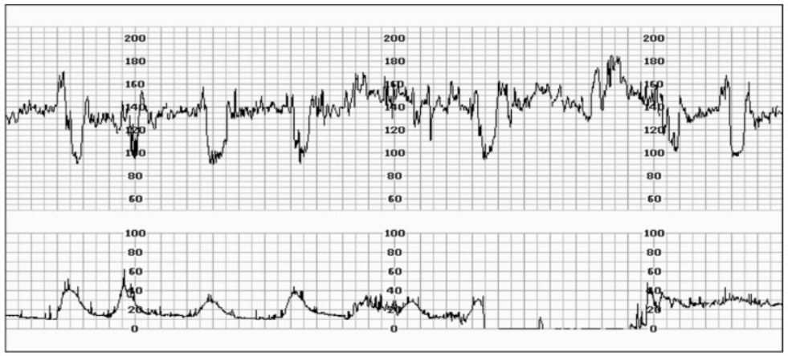
SO,WE GET SOME DATA

Slide 9
Dataset Introduction
Dataset consists 2,126 records of 22 features, which were then classified by expert obstetricians into 3 classes:
• Normal
• Suspect
• Pathological

Slide 10
INDEPENDENT FEATURES DETAILS: -
There are 21 features in my dataset as shown below: -
baseline value FHR baseline (beats per minute)
accelerations Number of accelerations per second
fetal_movement Number of fetal movements per second
uterine_contractions Number of uterine contractions per second
light_decelerations Number of light decelerations per second
severe_decelerations Number of severe decelerations per second
prolongued_decelerations Number of prolonged decelerations per second
abnormal_short_term_variability Percentage of time with abnormal short-term variability

Slide 11
mean_value_of_short_term_variability Average value of short-term variability
percentage_of_time_with_abnormal_long_term_variability Percentage of time with abnormal long term variability
mean_value_of_long_term_variability Average value of long-term variability
histogram_width Width of the FHR histogram.
histogram_min Minimum (low frequency) of the FHR histogram
histogram_max Maximum (high frequency) of the FHR histogram
histogram_number_of_peaks Number of histogram peaks
histogram_number_of_zeroes Number of zeros of the histogram
histogram_mode Fashion of the histogram
histogram_mean Mean of the histogram

Slide 12
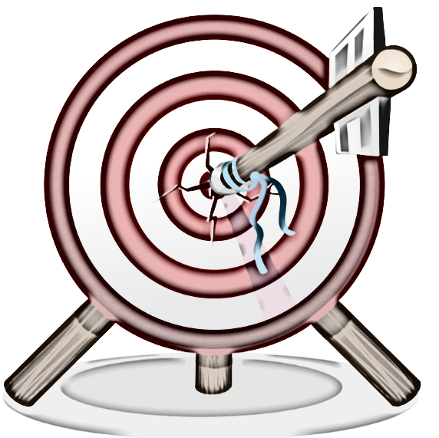
histogram_median Median of the histogram
histogram_variance Variance of the histogram
histogram_tendency Tendency of the histogram
TARGET FEATURE/DEPENDENT FEATURE
fetal_health
Marked as
1 (Normal)
2 (Suspicious)
3 (Pathological)

Slide 13
GOAL -
Our primary objective is to make a suitable model for fetal health classification which gives low False Positive Rate with high F-1 Score and high accuracy.
Additionally, we are keen on identifying the specific independent features that exert a substantial influence on fetal health.

Slide 14
LET’S DO SOME
Data analysis.

Slide 15
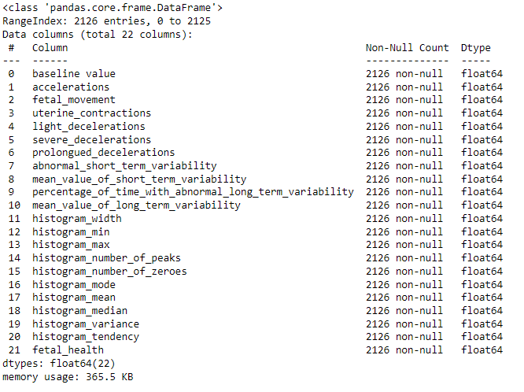
Concise information of data
From the graph, we find some valuable information as shown below: -
There are 2126 rows with entries 0 to 2125.
There are 22 Columns.
There is no null value.
Data type of all features is in float64.
Memory usage is 365.5 KB.

Slide 16
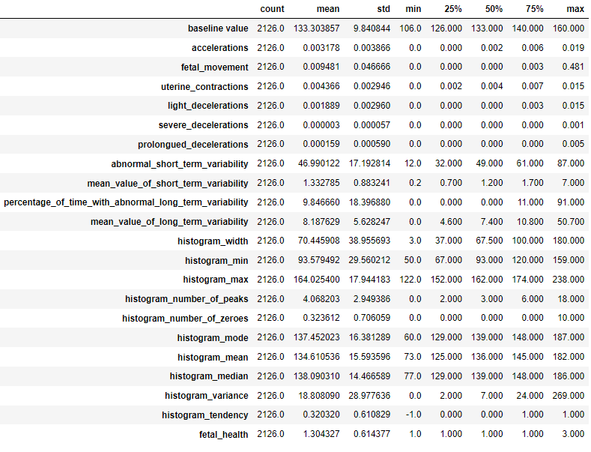
Describe the data
Here we find information about all the numerical features in our dataset.
1. Count.
2. Mean.
3. Standard Deviation.
4. Min value of feature.
5. Max. value of feature.
6. Interquartile range value

Slide 17
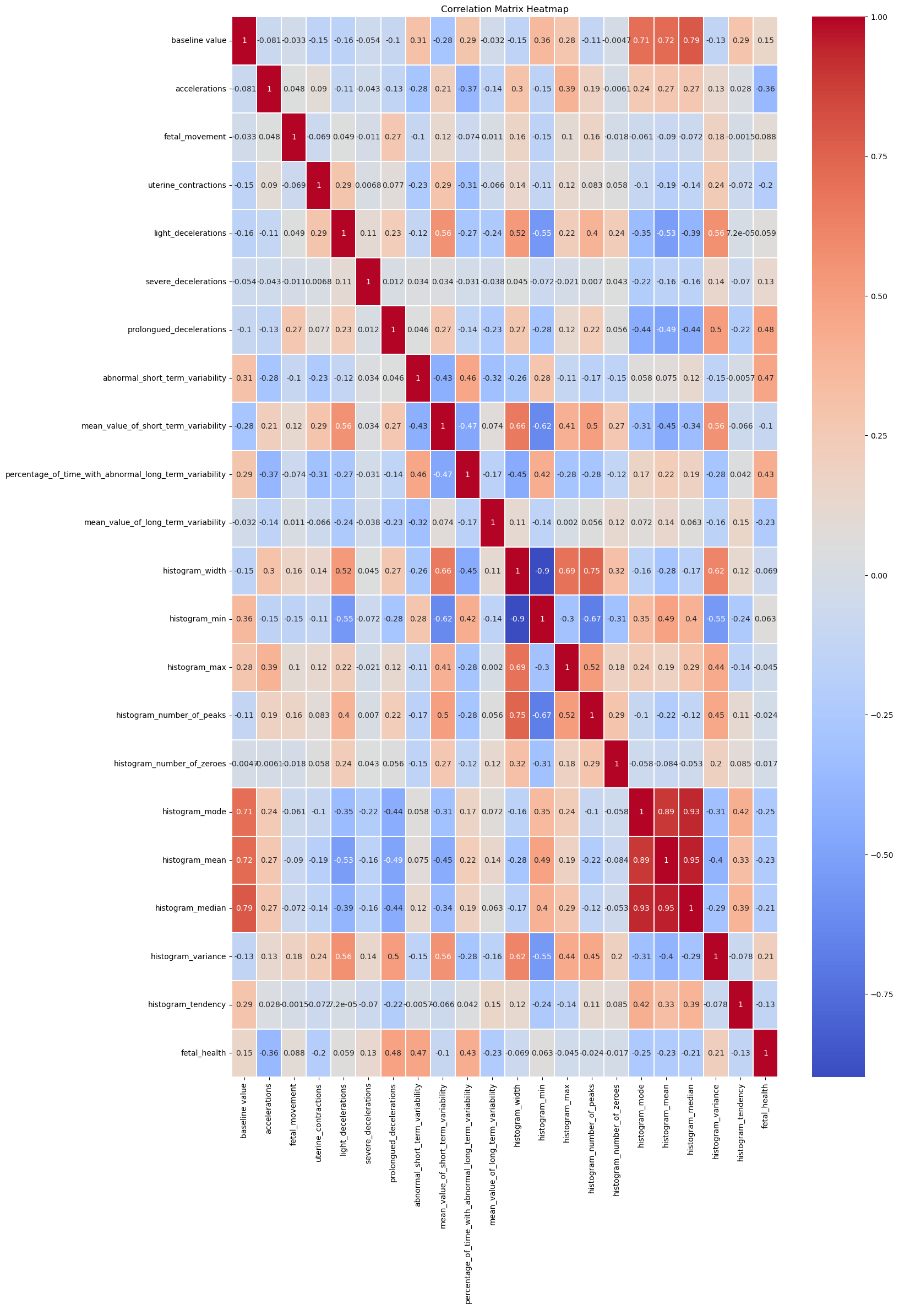
Corelation between all the features.
Red Colour shows highly corelated features.
Here, we find that not a single feature highly corelated to our target feature.
But, abnormal_short_term_variability and prolongued_decelerations have some impact on fetal_health/ target feature.
And, Some features are highly corelated to each other.

Slide 18
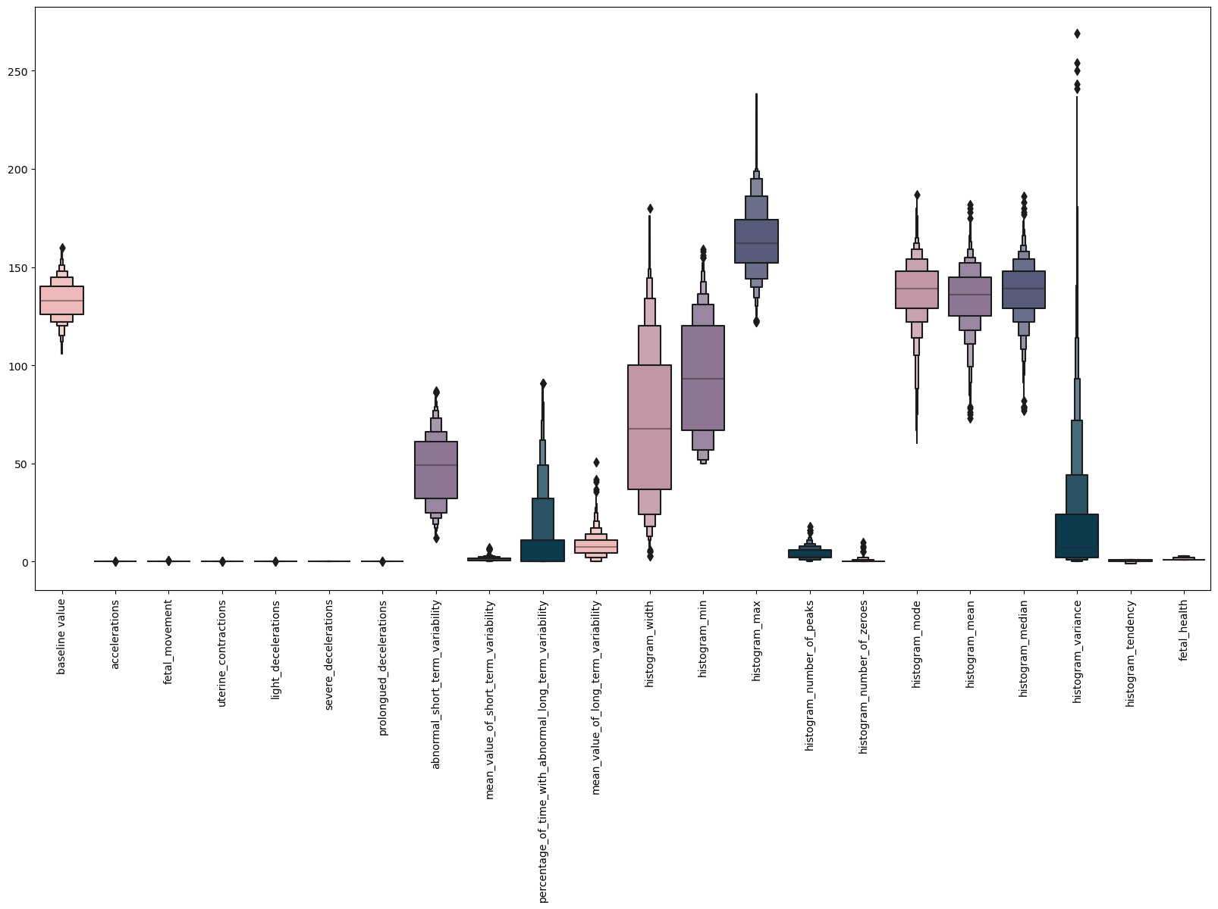
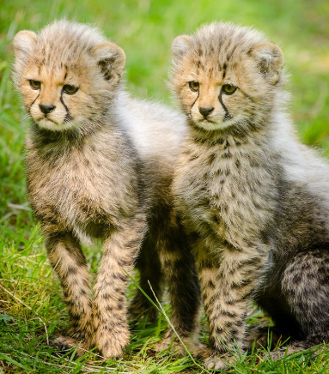
Variance of data
So many outlier.
Negligible variation in some features, it means that the data points are very close to the mean, and there is little dispersion or variability.
In practical terms, negligible variance implies that the values in the dataset are relatively uniform and consistent, suggesting a high degree of similarity among the data points.

Slide 19
AS WE KNOW DUPLICATE DATA AND SIMILAR DATA POINTS IN A FEATURE IS NOT GOOD FOR BETTER PREDICTION.
AND CONSTANT FEATURES ARE ALSO NOT GOOD FOR A MODEL. BECAUSE OF THERE NEGLIGIBLE INFLUENCE ON TARGECT FEATURE.
SO, LETS DO FEATURE SELECTION FOR GETTING NON-CONSTANT FEATURE FROM OUR DATA FOR BETTER PREDICTION OF OUR TARGET FEATURE.
WITH THE HELP OF “VARIANCE THRESHOLD” LIBRARY OF SKLEARN WE GET NON-CONSTANT FEATURES FROM OUR DATA.

Slide 20
Non-Constant Independent Features are as below: -
baseline value
abnormal_short_term_variability
mean_value_of_short_term_variability
percentage_of_time_with_abnormal_long_term_variability
mean_value_of_long_term_variability
histogram_width
histogram_min
histogram_max
histogram_number_of_peaks
histogram_number_of_zeroes
histogram_mode
histogram_mean
histogram_median
histogram_variance
histogram_tendency
NOW SHAPE OF OUR DATA BECOME
(2126,16)

Slide 21
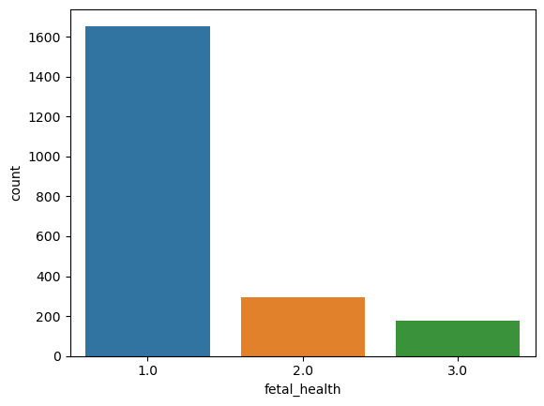

Check The Event Rate of Target Feature
Here we finds that Our data is highly imbalanced.

Slide 22

TWO WAYS

Slide 23
1. Balance the imbalanced data.
2. Go ahead with the same data.

Slide 24
If we try to balance the data with the help of artificial data. Then so many possibility that our data becomes duplicate.
As we know duplicate data is not good for our prediction or for model’s good accuracy. So, Lets try the second way if it give bad accuracy then we go with the first way.

Slide 25
Lets distribute the data –
In the independent feature and the dependent feature, here we use only 2000 rows data for the training and testing of the model.
126 rows of data we take in spare as a outer data to test our model.

Slide 26
TRAN_TEST_SPLIT 2000
TRAINING DATA TESTING DATA
80% 20%

Slide 27
STANDARDIZED THE DATA
By StandardScaler
It is a preprocessing technique in machine learning that standardizes the features by removing the mean and scaling to unit variance.

Slide 28
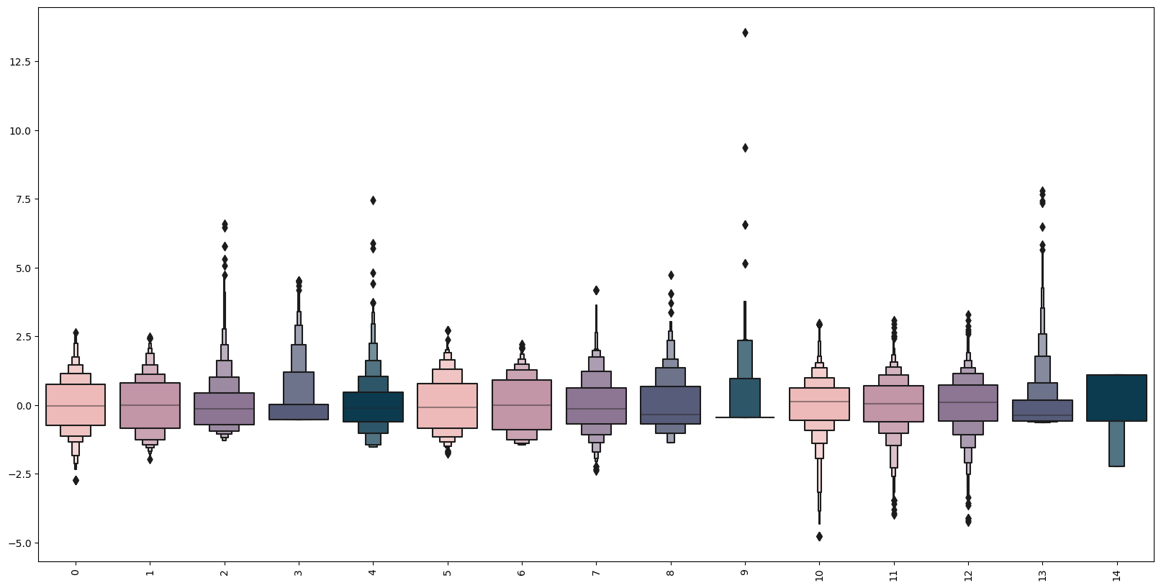
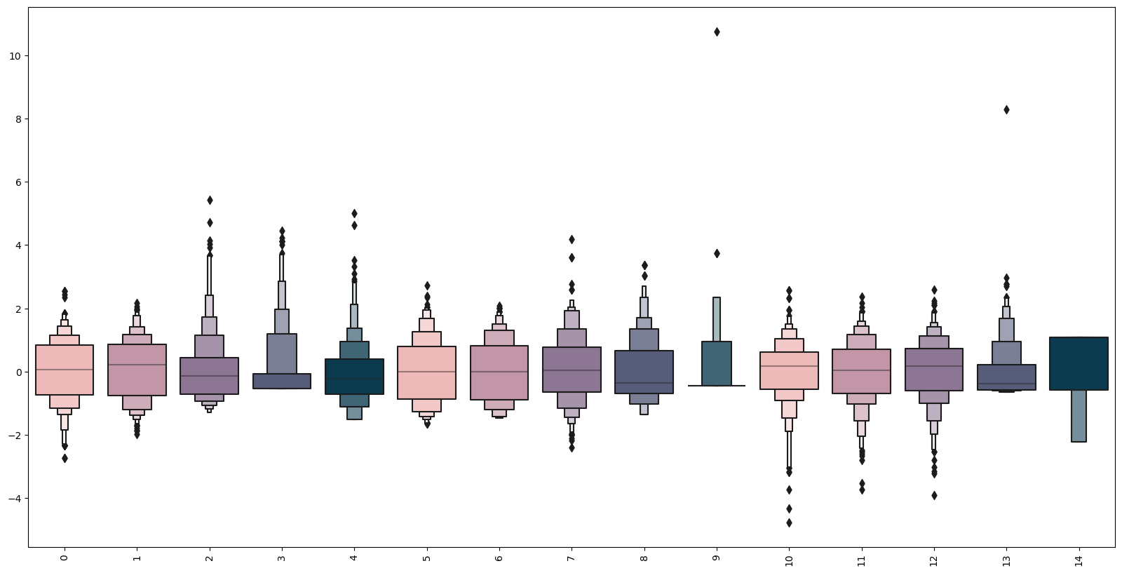
AFTER STANDARIZATION, OUR DATA LOOKS AS
Training Data
Testing Data

Slide 29
OUR MODELLING APPROACH: -
CLASSIFICATION PROBLEM
SO OUR EVALUATION METRICS ARE AS FOLLOWS: -
CONFUSION MATRIX
ACCURACY SCORE
CLASSIFICATION REPORT

Slide 30
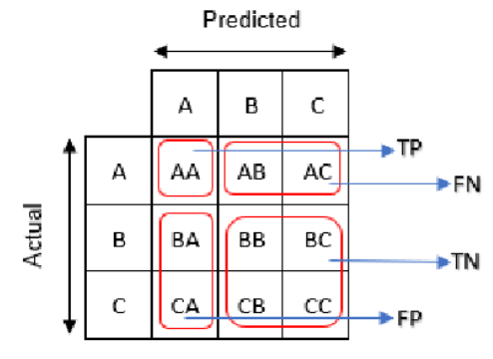
Confusion Matrix:
A Confusion matrix or error matrix is a table that shows the number of correct and incorrect predictions made by the model compared with the actual classifications in the test set or what type of errors are being made.
Four possible outcomes could occur while performing classification prediction –
True Positive (TP): Number of outcomes that are actually positive and are predicted positive.
True Negative (TN): Number of outcomes that are actually negative and are predicted negative.
False Positive (FP): Number of outcomes that are actually negative but predicted positive. These errors are also called Type 1 Errors.
False Negative (FN): Number of outcomes that are actually positive but predicted negative. These error are also called Type 2 Errors.

Slide 31

2. Accuracy Score: -
Accuracy is a performance metric that measures the percentage of correctly predicted instances out of the total instances.
Formula:

Slide 32



3. Classification Report:
It provides a comprehensive view of how well a model has performed in terms of various evaluation metrics for each class in a classification problem. The report is particularly useful when dealing with problems where the classes are imbalanced.
It a useful metric for imbalanced datasets.

Slide 33
APPLIED MODELS: -
RANDOM FOREST CLASSIFIER (RFC)
SUPPORT VECTOR CLASSIFIER (SVC)
DECISION TREE CLASSIFIER (DTC)

Slide 34
RANDOM FOREST CLASSIFIER (RFC)
(ON TRAINING)
CONFUSION MATRIX
Predicted Fetal Health
Actual Fetal Health
 | 1 | 2 | 3
1 | 1237 | 0 | 0
2 | 0 | 231 | 0
3 | 0 | 0 | 132
ACCURACY SCORE
Here accuracy score of training is 100% (because model correctly predicted all the classes).
CLASSIFICATION REPORT
 | Precision | Recall | F-1 Score
1 | 1.00 | 1.00 | 1.00
2 | 1.00 | 1.00 | 1.00
3 | 1.00 | 1.00 | 1.00

Slide 35
RANDOM FOREST CLASSIFIER (RFC)
(ON TESTING)
CONFUSION MATRIX
Predicted Fetal Health
Actual Fetal Health
 | 1 | 2 | 3
1 | 307 | 4 | 2
2 | 18 | 38 | 3
3 | 3 | 0 | 25
ACCURACY SCORE
Here accuracy score of training is 92.5%.
CLASSIFICATION REPORT
 | Precision | Recall | F-1 Score
1 | 0.94 | 0.98 | 0.96
2 | 0.90 | 0.64 | 0.75
3 | 0.83 | 0.89 | 0.86

Slide 36
When I check prediction of our RFC model with the outer data which is not included in training and testing data of the model.
It correctly predict 3 fetal health out of 4. (3/4)

Slide 37
2. SUPPORT VECTOR CLASSIFIER (SVC)
(ON TRAINING)
CONFUSION MATRIX
Predicted Fetal Health
Actual Fetal Health
 | 1 | 2 | 3
1 | 1218 | 19 | 0
2 | 73 | 157 | 1
3 | 4 | 20 | 108
ACCURACY SCORE
Here accuracy score of training is 92.68%.
CLASSIFICATION REPORT
 | Precision | Recall | F-1 Score
1 | 0.94 | 0.98 | 0.96
2 | 0.80 | 0.68 | 0.74
3 | 0.99 | 0.82 | 0.90

Slide 38
2. SUPPORT VECTOR CLASSIFIER (SVC)
(ON TESTING)
CONFUSION MATRIX
Predicted Fetal Health
Actual Fetal Health
 | 1 | 2 | 3
1 | 307 | 5 | 1
2 | 20 | 38 | 1
3 | 3 | 4 | 21
ACCURACY SCORE
Here accuracy score of training is 91.5%.
CLASSIFICATION REPORT
 | Precision | Recall | F-1 Score
1 | 0.93 | 0.98 | 0.95
2 | 0.81 | 0.64 | 0.72
3 | 0.91 | 0.75 | 0.82

Slide 39
When I check prediction of our RFC model with the outer data which is not included in training and testing data of the model.
It correctly predict 3 fetal health and incorrectly 1 out of 4.

Slide 40
3. Decision tree classifier (dtc)
(ON TRAINING)
CONFUSION MATRIX
Predicted Fetal Health
Actual Fetal Health
 | 1 | 2 | 3
1 | 1233 | 4 | 0
2 | 34 | 195 | 2
3 | 6 | 8 | 118
ACCURACY SCORE
Here accuracy score of training is 96.62%.
CLASSIFICATION REPORT
 | Precision | Recall | F-1 Score
1 | 0.97 | 1.00 | 0.98
2 | 0.94 | 0.84 | 0.89
3 | 0.98 | 0.89 | 0.94

Slide 41
3. Decision tree classifier (dtc)
(ON TESTING)
CONFUSION MATRIX
Predicted Fetal Health
Actual Fetal Health
 | 1 | 2 | 3
1 | 304 | 6 | 3
2 | 21 | 32 | 6
3 | 4 | 3 | 21
ACCURACY SCORE
Here accuracy score of training is 89.25%.
CLASSIFICATION REPORT
 | Precision | Recall | F-1 Score
1 | 0.92 | 0.97 | 0.95
2 | 0.78 | 0.54 | 0.64
3 | 0.70 | 0.75 | 0.72

Slide 42
When I check prediction of our RFC model with the outer data which is not included in training and testing data of the model.
It correctly predict 4 fetal health out of 4.

Slide 43
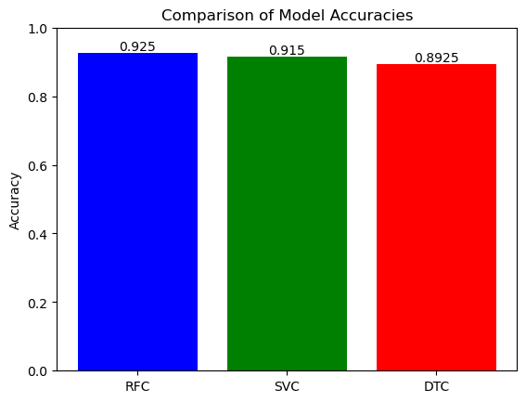
COMPARISION OF MODEL’S ACCURACY : -
RANDOM FOREST CLASSIFIER GIVING MAXIMUM ACCURACY.

Slide 44
AS WE KNOW OUR DATA IS IMBALANCED. SO, WE HAVE TO FIND WHICH MODEL GIVE BEST F-1 SCORE.
RFC | Precision | Recall | F-1 Score
1 | 0.94 | 0.98 | 0.96
2 | 0.90 | 0.64 | 0.75
3 | 0.83 | 0.89 | 0.86
SVC | Precision | Recall | F-1 Score
1 | 0.93 | 0.98 | 0.95
2 | 0.81 | 0.64 | 0.72
3 | 0.91 | 0.75 | 0.82
DTC | Precision | Recall | F-1 Score
1 | 0.92 | 0.97 | 0.95
2 | 0.78 | 0.54 | 0.64
3 | 0.70 | 0.75 | 0.72
It is clearly visible that RFC model is giving higher F-1 score for all the classes with higher precision value.

Slide 45
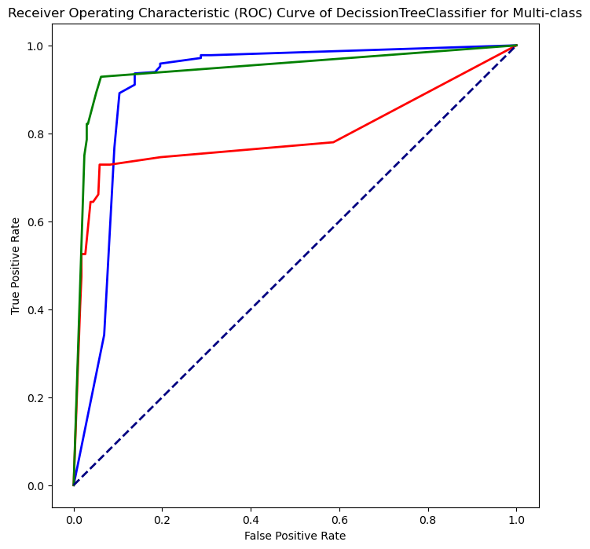
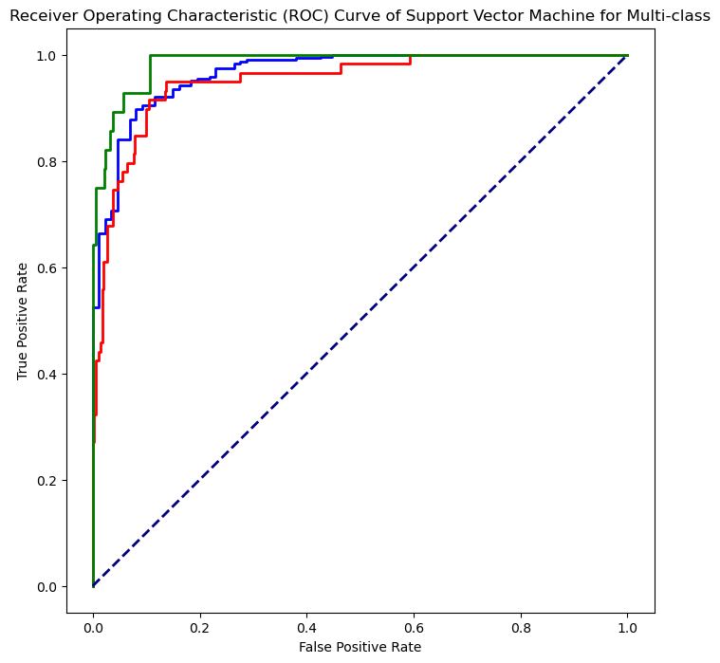
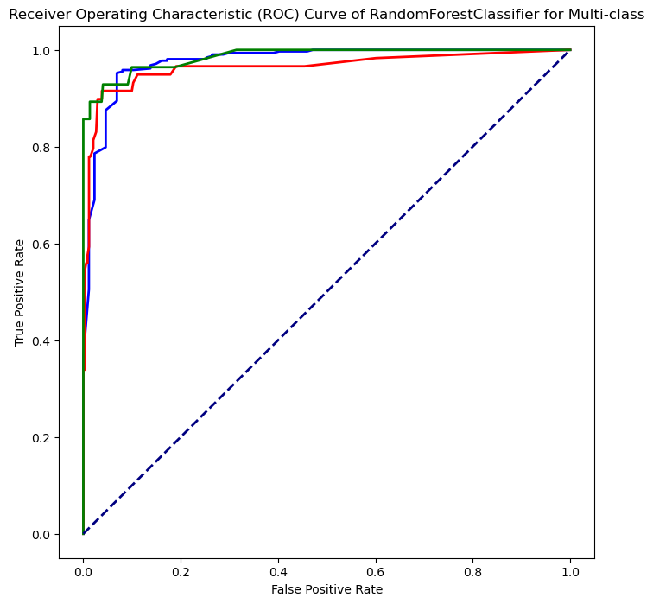
COMPARE ROC CURVE OF ALL MODELS : -
Random Forest Classifier model with smooth upward trajectory of ROC curve maintains a high true positive rate while keeping a low false positive rate.

Slide 46
Finalization of Model: -
Due to : -
High F-1 Score.
High Accuracy.
Smooth upward trajectory of ROC curve
We can say that Random Forest Classifier model is best out of these three models.

Slide 47
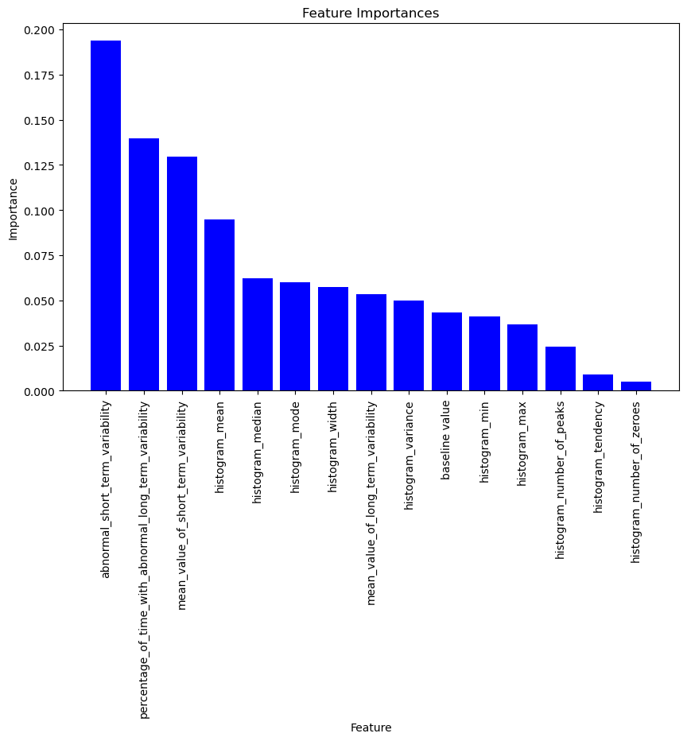
Which independent feature more influence the target feature in Random Forest Classifier Model?

Slide 48
CONCLUSION :-
1. After extensive analysis, it is evident that the Random Forest Classifier emerges as the optimal model for fetal health classification. Its superior accuracy surpasses that of other models, and the receiver operating characteristic curve demonstrates an impressive ability to classify all classes with an exceptionally low false positive rate.
2. The feature data related to short-term variability in abnormality plays a pivotal role in fetal health classification.

Slide 49
How random forest classifier model can be leveraged in other domains/ or can be scaled with some more tweaks?
The Random Forest Classifier model is versatile and can be adapted for use in various domains due to its ability to handle different types of data. Here are ways the Random Forest model can be leveraged in other domains:
Education:
(a). Course Recommendation: Suggest suitable courses for students based on their academic history and preferences.

Slide 50
2. Human Resources:
(a)Talent Acquisition: Assist in identifying suitable candidates for job roles based on resumes and historical hiring data.
3. Energy:
(a) Fault Detection in Power Grids: Use the model to detect faults and anomalies in power grids for improved reliability.
The Random Forest Classifier's adaptability makes it a valuable tool in many domains, and its performance can be enhanced through feature engineering and hyperparameter tuning.

Slide 51
Coding file link: -

Slide 52

Thank you for watching the capstone presentation so carefully and thoroughly.

